Slide 1
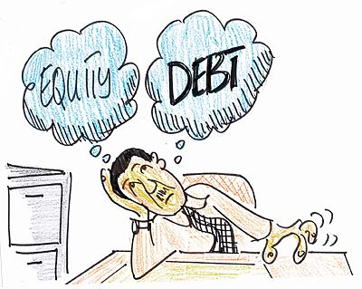
Capital structure

Slide 2
Modigliani-Miller and capital structure
Modigliani-Miller theorem states that, in a frictionless world without taxes, the value of the firm is independent of the relative proportion of debt and equity in its capital structure.
Value of the firm is derived from the operations of the company. It should not/does not matter how the pie is split between debtholders and shareholders.

Slide 3
Modigliani-Miller theorem
Cost of capital of debt < Cost of capital of equity.
As leverage increases, cost of capital of both debt and equity increase.
But the cost of capital for the firm remains the same.
Why? It is dark magic. ☺
They were awarded a Nobel Prize for this!

Slide 4
Debt vs. equity fallacies
Leverage decreases earnings → Leverage is bad for stock price.
Leverage increases EPS → Leverage is good for stock price.
Issuing equity leads to dilution of equity ownership → Debt financing should be preferred.

Slide 5
Fallacy: Earnings and leverage
Consider Jalal Enterprise: No debt, EBIT of ₹10 lakh, 10 lakh shares, Price of share is ₹7.5
EPS = 10/10 = ₹1
Market value = ₹7.5×10 = ₹75 lakh
Jalal wants to borrow ₹15 lakh at an interest rate of 8%.
Should he?

Slide 6
Fallacy: Earnings and leverage …
New interest = ₹15×8% = ₹1.2 lakh
New earnings = 10−1.2 = ₹8.8 lakh < ₹10.0 lakh
But what will he do with the ₹15 lakh of borrowed money?
The proceeds will be used to repurchase 2 lakh shares at ₹7.5/share.
New EPS = 8.8/8 = ₹1.1 > ₹1.0
The new equity is levered and riskier than old equity. Even though EPS is higher, cost of capital is higher. The new share price remains the same.

Slide 7
Fallacy: Equity dilution
Consider Babu Airlines (BA): No debt, 50 lakh shares, Price of share is ₹16
Market value = ₹16×50 = ₹8 crore
If BA needs additional ₹1 crore for expansion, should it issue equity?

Slide 8
Fallacy: Equity dilution …
To raise ₹1 crore, BA can issue 6.25 lakh shares at ₹16 per share.
New #shares = 50+6.25 = 56.25 lakh
New market value = 8+1 = ₹9 crore
New price = ₹9 crore/56.25 lakh = ₹16
As long as the firm sells the new shares of equity at a fair price, there will be no gain or loss to shareholders associated with the equity issue itself.

Slide 9
Taxes
In a world with taxes, when a company introduces debt in its balance sheet, it will pay less in taxes (compared to an unlevered, but otherwise similar, company). The tax advantage of debt increases the value of the firm. The tax shield (less tax paid to the government) accrues to the shareholders.
Using the pie analogy, there are three claimants: Shareholders, Bondholders, and Income Tax Department. In the presence of debt, the share of pie for the IT Department is lower. The shareholders benefit from the rest.

Slide 10
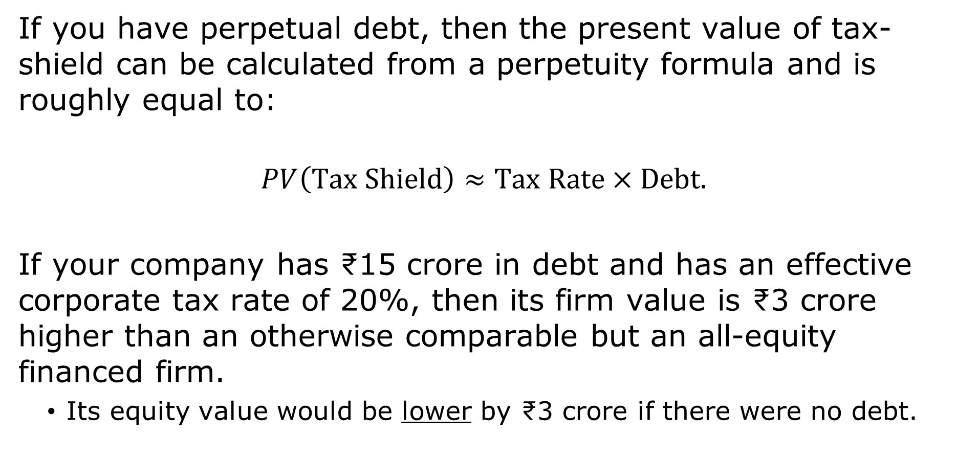
Value of tax shield
If you have perpetual debt, then the present value of tax-shield can be calculated from a perpetuity formula and is roughly equal to:
$$PV\left(Tax Shield\right)≈Tax Rate×Debt.$$
If your company has ₹15 crore in debt and has an effective corporate tax rate of 20%, then its firm value is ₹3 crore higher than an otherwise comparable but an all-equity financed firm.
Its equity value would be lower by ₹3 crore if there were no debt.

Slide 11
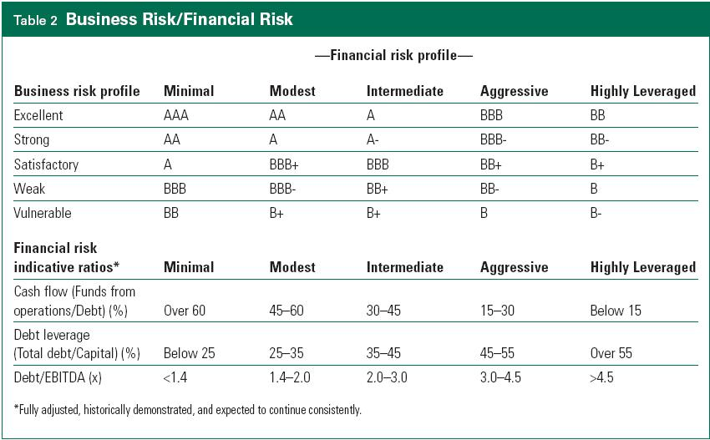
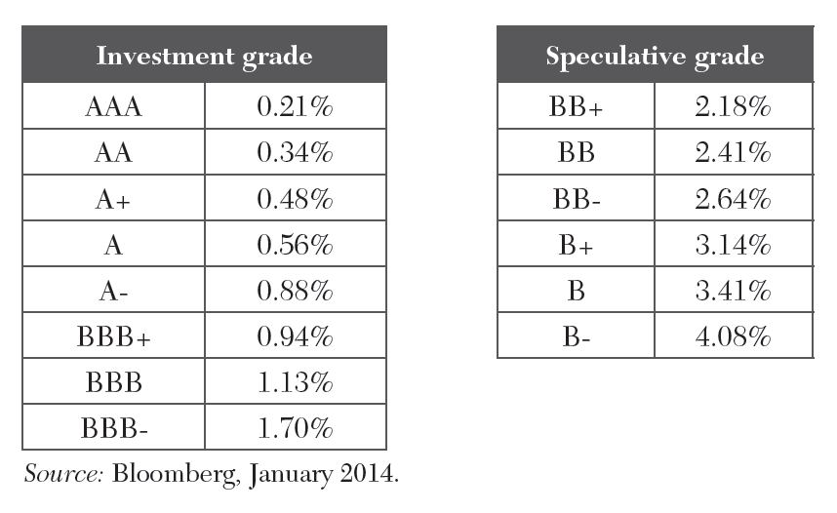
Leverage and risk
As leverage goes up, so does cost of debt.

Slide 12

Leverage and risk …
And also the cost of equity.
$$CC_{equity}^{Levered}=CC_{equity}^{Unlevered}+\frac{D}{E}×\left(CC_{equity}^{Unlevered}−CC_{debt}\right).$$

Slide 13
Quiz
Despite the increase in riskiness of debt and equity, if debt creates value through tax shield, why not go all the way?
(Most) companies should be 100% debt financed as debt has only tax benefits but no costs.
Common sense suggests otherwise. Therefore, debt must have costs as well.

Slide 14
Leverage and bankruptcy
Bankruptcy costs are incremental costs associated with financial distress, above and beyond any losses due to the firm’s economic distress.
Direct costs.
Legal fees, management time, experts’ fees.
Indirect costs.
Loss of customers/suppliers.
Loss of employees.
Loss of receivables.
Fire sale of assets.

Slide 15
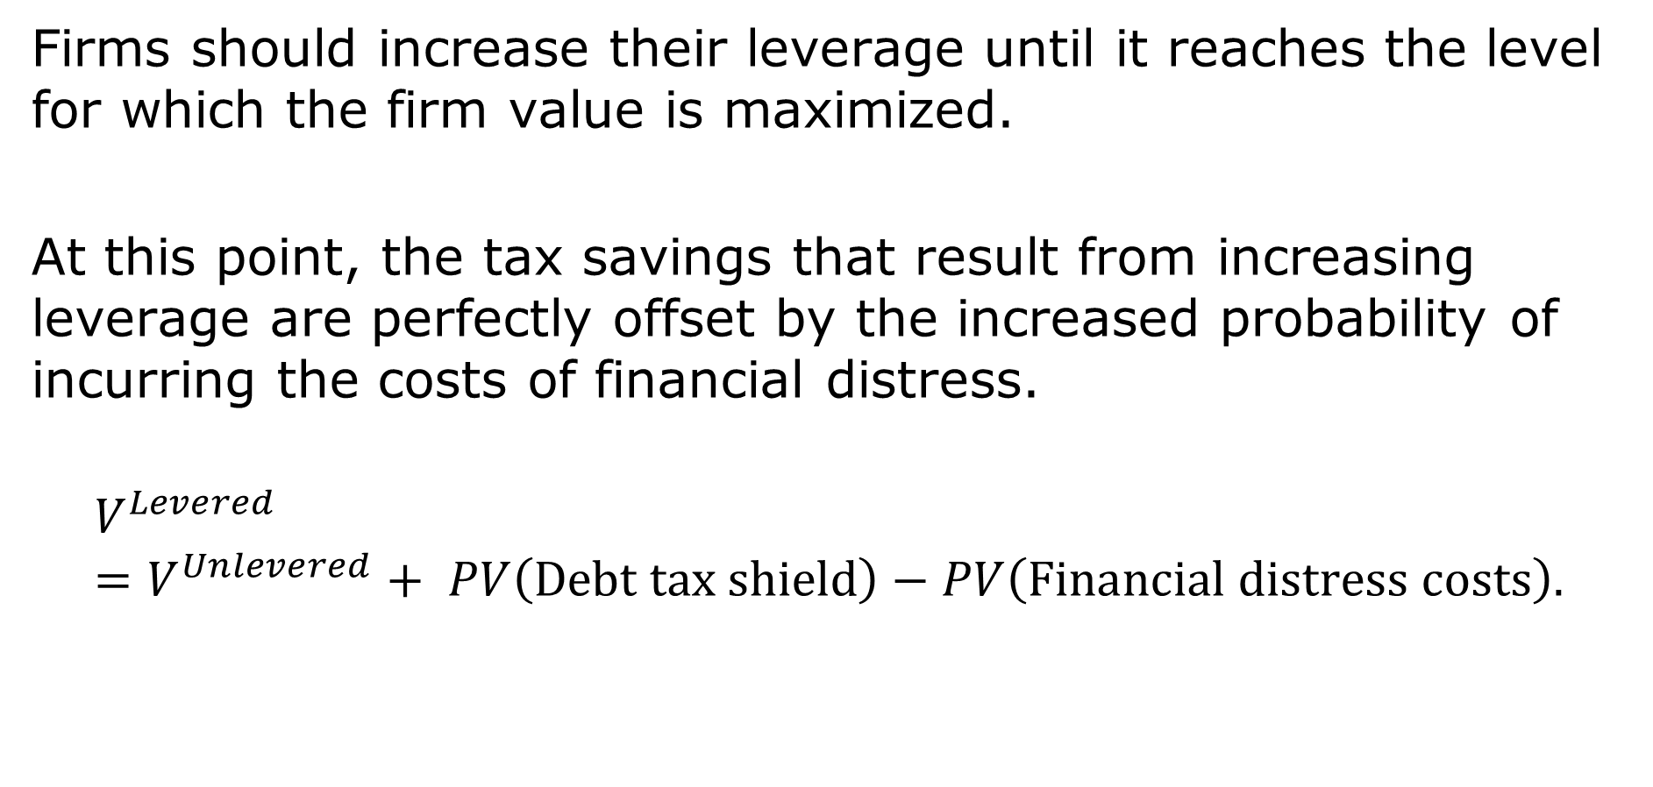
Tradeoff theory
Firms should increase their leverage until it reaches the level for which the firm value is maximized.
At this point, the tax savings that result from increasing leverage are perfectly offset by the increased probability of incurring the costs of financial distress.
$$V^{Levered}=V^{Unlevered}+ PV\left(Debt tax shield\right)−PV\left(Financial distress costs\right).$$

Slide 16
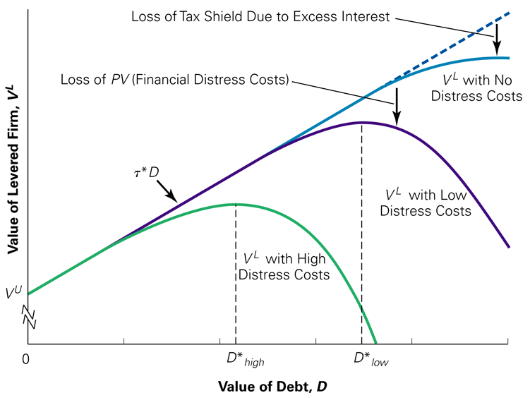
Tradeoff theory and optimal debt level

Slide 17
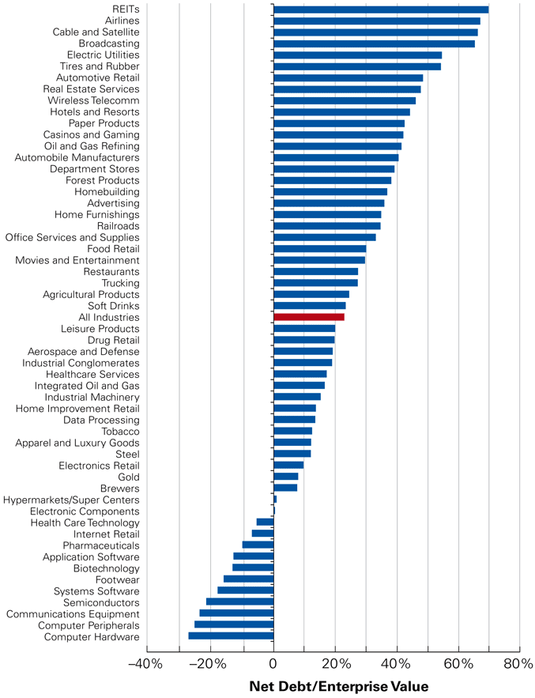
Debt/Value across industries

Slide 18
Trade-off theory is not all
If we explain the world using only trade-off theory:
A firm needing external financing, but which is already highly leveraged, will always issue equity to finance the investment.
But this does not sound right.
General aversion to equity issuance.
Infrequency of equity issues.
Sometimes are better than others to tap equity markets (e.g., hot and cold equity markets).

Slide 19
Other costs of leverage
Leverage can encourage managers to act ex-post in ways that benefit equity-holders at the expense of debtholders but reduces firm value.
Debtholders recognize this possibility and pay less for the debt (or charge a higher interest rate) when debt is issued.
Ex-ante, it is the shareholders of the firm who bear these agency costs.
Debt covenants can help debtholders but impose a loss of flexibility, and thus value, for shareholders.

Slide 20
Other benefits of leverage
Agency benefits
Management entrenchment may allow managers to run the firm in their own best interests, rather than in the best interests of the shareholders.
Leverage may tie the managers’ hands and commit them to pursue strategies with greater vigor than they would without the threat of financial distress.

Slide 21
Other benefits of leverage
Asymmetric information
Managers have superior information to investors regarding the firm’s future cash flows but cannot discuss the project due to competitive reasons.
(Signaling value of debt): One way to credibly communicate this positive information is to commit the firm to large future debt payments.
If the manages issue equity, investors will discount the price they are willing to pay to reflect the possibility that managers have bad news.

Slide 22
Optimal capital structure
Value of Levered Firm =
Value of Unlevered Firm
+ PV(Debt tax shield)
− PV(Financial distress costs)
− PV(Other costs of debt)
+ PV(Agency benefits of debt)
+ PV(Asymmetric information benefits of debt).

Slide 23
Optimal debt level: Practical tips
Low debt:
High distress costs.
High agency costs.
Low agency benefits.
Low info. benefits.
R&D intensive firms.
Biotech, tech firms.
Intangible assets firms (Chanel).
High debt:
Low distress costs.
Low agency costs.
High agency benefits.
High info. benefits.
Mature firms.
Low-growth firms.
Airlines.
Retailers.
Real-estate, utilities.

Slide 24
Success/failure of enhanced trade-off theory
Success of trade off theory:
Differences across industries (Software vs. Airlines).
Targets of LBOs are mature cash-cows companies.
Companies with heavy debt tend to issue stock to rebalance capital structure.
Failure of trade-off theory:
Debt ratios are not lower in countries where tax advantage of debt is much smaller (e.g., Australia).
Predicts no difference between internal funding and equity.

Slide 25
Pecking order theory
In practice, companies are reluctant to issue equity.
They follow a “pecking order” in which they finance investment:
first with internally generated funds,
then with debt (unless already highly leveraged),
and finally with equity.
They may even forgo positive NPV investments because of reluctance to raise additional external financing.

Slide 26
Market timing
Managers who perceive the firm’s equity is underpriced will have a preference to fund investment using retained earnings, or debt, rather than equity.
The converse is also true: Managers who perceive the firm’s equity to be overpriced will prefer to issue equity, as opposed to issuing debt or using retained earnings, to fund investment.
The stock price typically declines on the announcement of an equity issue.
The firm’s overall capital structure depends in part on the market conditions that existed when it sought funding in the past.

